Slide 1

Design and Analysis of the Drive Train of an All-Terrain Vehicle
K. J. Somaiya College of Engineering, Mumbai-77
(Autonomous College Affiliated to University of Mumbai)
Priyank Mehta-1115081, Rohit Salgaonkar-1115091, Soham Gokhale-1115103
Project Guide: Prof. V S Narwane

Slide 2
Introduction
Our project includes the design, analysis and manufacture of the entire Drive train system of an all-terrain vehicle, in association with RedShift Racing India, which participates in BAJA competitions.
Objective of Project:
Design and analysis of components including the gears, rear axle, housing, etc.
Study of performance characteristics of the CVT and parameters that determine them. Study of CVT tuning and implementation.
Study of Vibrational analysis of an engine. Experimental analysis of the current engine and suitable damping and mounting of the engine.
Goals of Project:
Design a smooth and efficient transmission system to successfully complete the Hill Climb, Traction and Endurance Event.
Provide maximum acceleration through CVT Tuning.
Design and optimize transmission system to match and compete with current ATV systems.

Slide 3
Design of the Gearbox
Determination of the reduction ratio.
Selecting the materials.
Calculating the modules of each stage.
Gear, shaft and key dimensions.
Selecting the bearings.
Designing the casing.
Analysis of the components.
Assembly.
Drafting and tolerances.

Slide 4
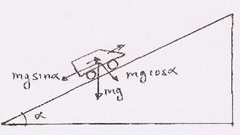
Determination of the reduction ratio:
Selecting the materials:
Steps | Outcomes
Calculation for maximum angle of inclination. | 34.999 degrees
Calculation for required torque. | 551.81 Nm
Calculation for total drive train reduction ratio | 41.385 to 43.56
Calculation for gearbox reduction ratio | 13.79 to 14.52
Selecting no. of teeth | Pinion 17. Gear 64 Actual Ratio 14.167
Material | Yield Strength (N/mm²) | BHN
EN 24 (1st stage reduction) | 700 | 280
EN 36 (2nd stage reduction) | 900 | 341

Slide 5
Calculating the modules of each stage:
Helix angle selected – 15 degrees
FOS considered – 2
Module selection equation - Lewis Equation
Bending strength (Fs) = Sb x b x y_{v} x π x m_{n}
Wear strength (Fw) = (b x d x Q x k)/cos²(b)
Aspect | Pinion 1 | Gear 1 | Pinion 2 | Gear 2
Number of teeth | 17 | 64 | 17 | 64
Material | EN 24 | EN 24 | EN 36 | EN 36
FOS | 2 | 2 | 2 | 2
Module | 2 | 2 | 3 | 3
P.C.D (mm) | 35.1994 | 132.515 | 52.799 | 198.77
Addendum dia. | 39.1994 | 136.1994 | 58.799 | 204.77
Dedendum dia | 30.1994 | 127.515 | 45.299 | 191.27

Slide 6
Gear, shaft and key dimensions:
Torque at input (T) = P x 60 / 2 x π x N
Bending moment, we take T_{eq} = 1.5 x T
Allowable sheer stress (Ss) = 0.3 x Sy
From torsion equation, we get d³= (16 x T_{eq} )/(π x Ss)
Selecting the bearings: 32005 X/Q, 32007 X/Q (SKF)
Designing the casing:
Material selected – LM6 (Aluminum Alloy)
Tensile Strength – 170 N/mm²
Shear Strength – 120 N/mm²

Slide 7
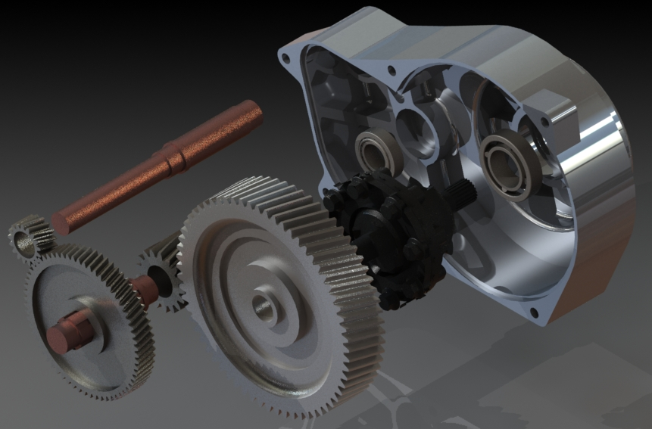
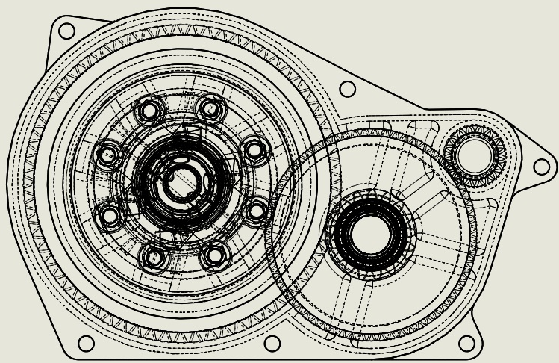
Design of the Gearbox

Slide 8
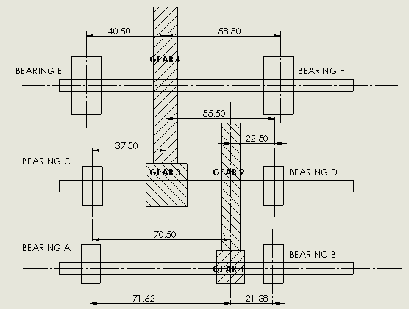
Gearbox Analysis
For the analysis of the gearbox, we have used the structural workbench on ANSYS.
The forces considered for the analysis of the gears are the tangential force components and the thrust components.
The forces considered for the housing dimensions are the bearing reactions due to the forces on the gears.

Slide 9
Gearbox analysis
Steps for analysis:
1. Importing Geometry 2. Assigning Material Properties
Geometry
Object Name | Gearbox
State | Fully Defined
Definition
Length Unit | Millimeters
Element Control | Program Controlled
Bounding Box
Length X | 0.178 m
Length Y | 0.33332 m
Material
Assignment | Aluminum Alloy LM 6 Series
Properties
Volume | 1.2939e-003 m³ | 9.5056e-004 m³
Mass | 3.4288 kg | 2.519 kg
Density | 2650 kg m^-3
Coefficient of Thermal Expansion | 2.e-005 C^-1
Specific Heat | 875 J kg^-1 C^-1
Young's Modulus Pa | 7.1e+010
Poisson's Ratio | 0.33
Bulk Modulus Pa | 6.9608e+010
Shear Modulus Pa | 2.6692e+010
Compressive Yield Strength Pa | 1.7e+008
Tensile Ultimate Strength Pa | 3.1e+008
Tensile Yield Strength Pa | 1.7e+008

Slide 10
3. Meshing: 4. Applying Boundary Conditions:
ond
Object Name | Gearbox Mesh
State | Solved
Physics Preference | Mechanical
Sizing
Element Size | 1.e-003 m
Minimum Edge Length | 1.7908e-004 m
Triangle Surface Mesh | Program Controlled
Advanced
Shape Checking | Standard Mechanical
Element Mid-side Nodes | Program Controlled
Straight Sided Elements | No
Number of Retries | Default (4)
Extra Retries For Assembly | Yes
Mesh Morphing | Disabled
Statistics
Nodes | 2056607
Elements | 1252306
All the mounting positions and bolting positions are fixed.
Axial thrust and radial forces are applied on bearing seats in proper directions.

Slide 11
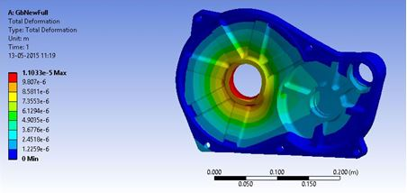
Gearbox Analysis
The table shows the analysis results for the housing
Stress(Pa) | 1.224x10⁷(max) | 449.2(min)
Deformation(m) | 1.1033x10⁻⁵(max) | 0(min)
Factor of safety | 6.6465

Slide 12
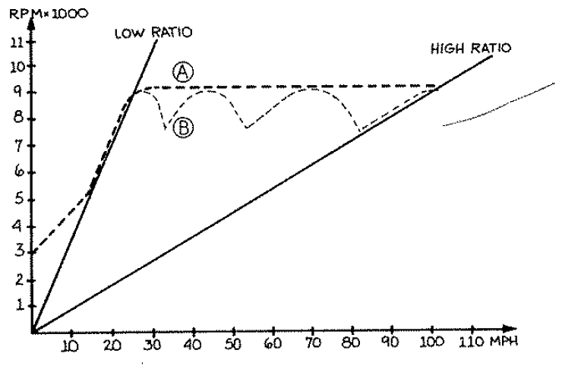
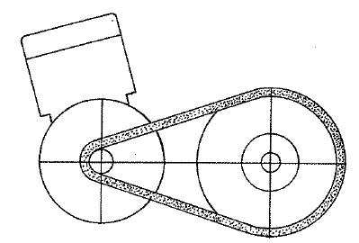
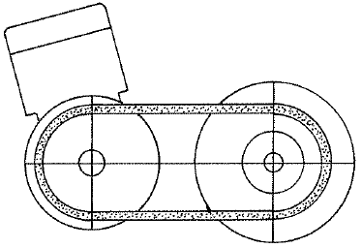
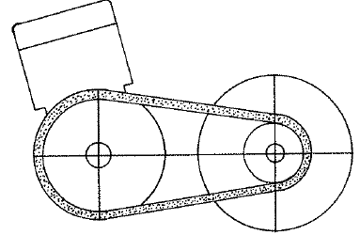
CVT
Engagement speed:
The engagement speed is the RPM of the driver of the CVT at which the belt gets engaged with the sheaves to rotate the driven.
Shift speed:
The shift speed is the speed of the engine where the velocity ratio shifts from the lower ratio to the higher ratio.

Slide 13
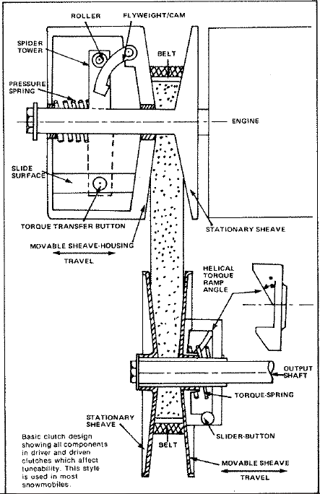
Components of CVT
Driver/ Primary Clutch
Pressure Spring: plays part in the engagement speed and in shifting from lower to higher gear ratio.
Flyweight Mechanism: utilizes centrifugal force to control engagement and shift speed.
Driven/ Secondary Clutch
Pretension Spring: plays a role in initial belt pressure and back shifting.
Torque Feedback Ramp: determine the amount of side force that acts on the sheaves.

Slide 14
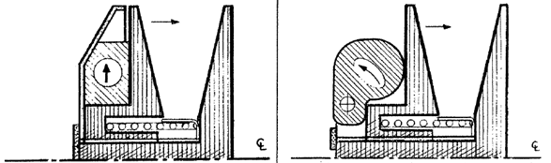
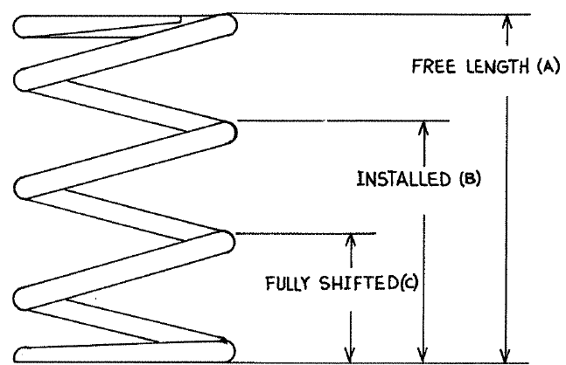
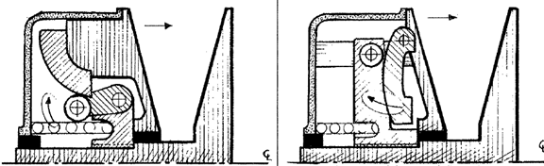
Driver/ Primary Clutch
1. Pressure Spring: 2. Flyweight Mechanism:

Slide 15
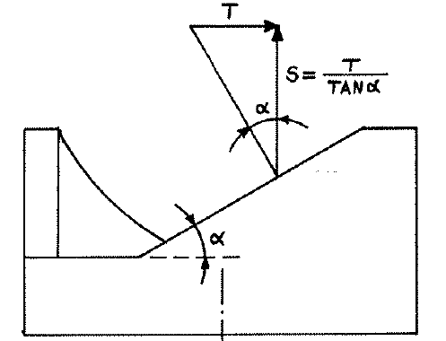
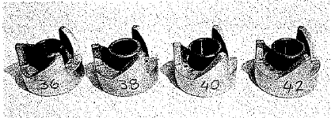
Driven/ Secondary Clutch
Pretension Spring:
Torque Feedback Ramp:

Slide 16
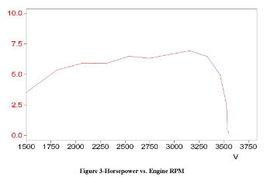
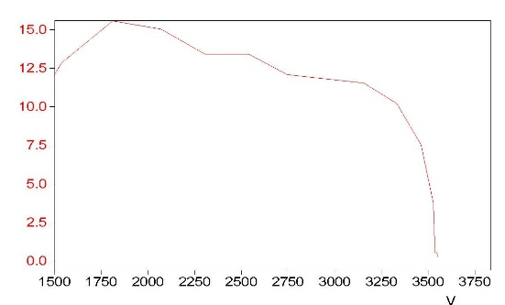
CVT tuning
Selecting the engagement rpm zone
Selecting the shift rpm zone
Selecting and playing with the weights and springs
Selecting the optimum parameters
Collecting data through testing
Fine tuning for better acceleration and efficiency

Slide 17
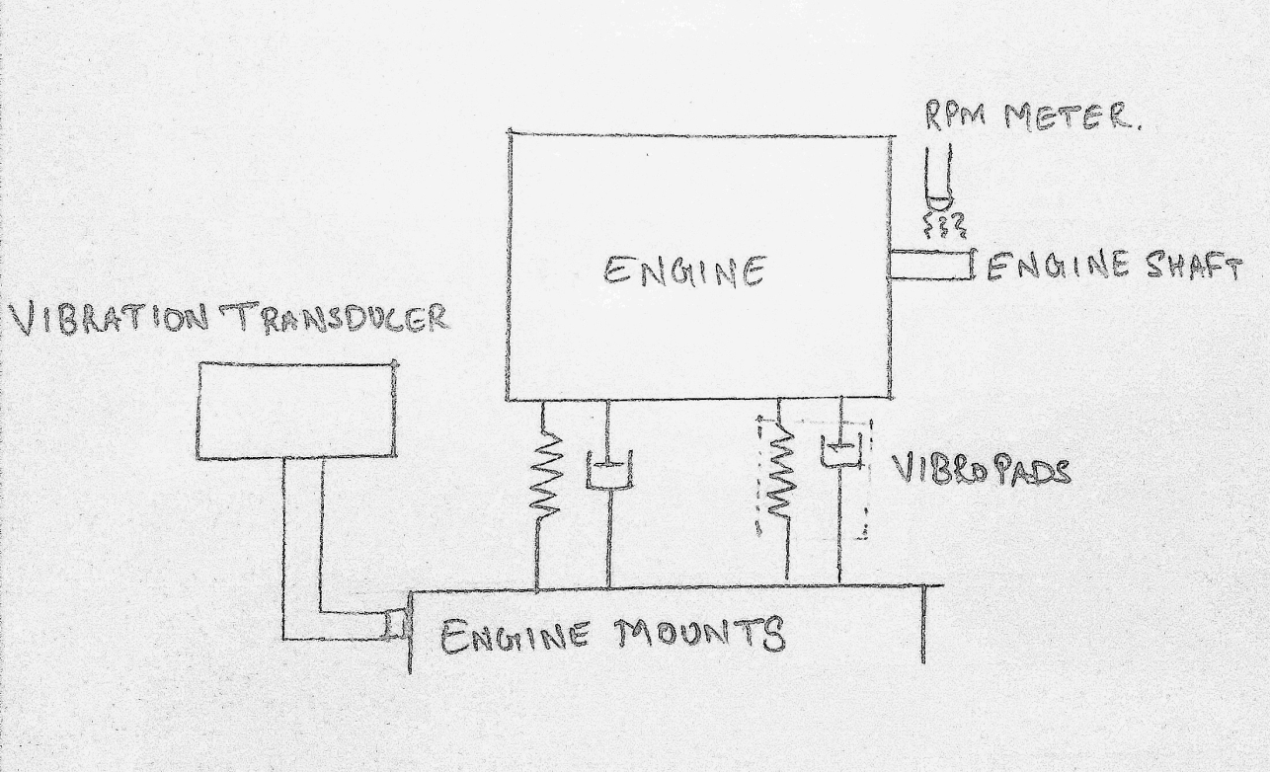
Engine Vibration Analysis
Aim of the experiment: To determine natural frequency of the engine using concepts of forced vibrations.
Experimental Setup

Slide 18
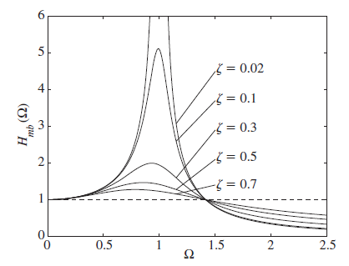
Determination of Natural Frequency
From graph Ftr/Fo=1 at r=√2
Where r= frequency ratio = Ѡ/Ѡn
Ftr= Force transmitted to foundation
Fo= External Excitation Frequency (Mo*e*Ѡ²)
Mo is the unbalance due to reciprocating piston of the engine

Slide 19
Determination of Unbalanced Mass
From Engine specifications,
Bore Diameter (D) = 3.23in = 82.042mm
Stroke Length (L) = 2.28in = 57.912mm
Therefore Length of crank shaft (e) = L/2= 28.956mm
Mass of reciprocating parts (Mo)= Mass of piston + Mass of gudgeon pin = 0.223 + 0.368 = 0.591 kg
Reciprocating unbalance = Mo.e = 0.591*28.956
= 0.0171 kg-m
Thus from unbalance mass Mo.e, Excitation force Fo at various speeds can be calculated.

Slide 20
Experimental Permutations to find Ѡn
The conditon of Ftr/Fo = 1 is obtained by trial and error method.
This condition is achieved at speed Ѡ = 2835 rpm
At this conditon,
Frequency ratio r = Ѡ/ Ѡn= √2
= 2835/ Ѡn = √2
Ѡn = 2004.64 rpm
=209.92 r/s
Since the natural frequency of the system is 2004.64 rpm, resonance will occur at this point.
The damping factor and damping coefficient of the mounts should be selected such that the engine is in isolation zone and should be able to sustain resonance condition.

Slide 21
Conclusion
Through the study of previous designs, we came to the conclusion that the implementation of a differential is imperative, for the required maneuverability.
Material research and property wise analysis helped us select Lm-6 series aluminum for the gearbox housing and EN-24 and EN-36 series for the gears.
Through revised designs, we have achieved an FOS of a minimum of 6.64 at maximum stressed section.
Permutations for CVT engagement and shift speed calculations provided us optimum values for the tuning parameters like flyweight values, spring loading and stiffness.
After rigorous testing and enduring for about 70kms run, the entire transmission system is performing consistently with satisfactory results. It has sustained all types of rough and inclined gradients successfully.
With suitable modifications the ATV has scope for application in various sectors such as military vehicle, for recreational sports and agricultural ploughing. They can also during natural calamities such as earthquakes to reach people who are inaccessible.

Slide 22
References
1.Design of Machine Elements – V. B. Bhandari, Tata McGraw-Hill Education, 2007.
2. Mechanical Engineering Design - J. E. Shigley, C. R. Mischke, R. G. Budynas, McGraw-Hill Series in Mechanical Engineering, Seventh edition.
3. Clutch Tuning Handbook- Olav Aeen.
4. Design Data Book- Compiled by PSG College of Engineering.
5. SKF Bearing Catalogue.
6. Fundamentals of Mechanical Vibrations - S. Graham Kelly, McGraw-Hill Series in Mechanical Engineering, December, 1992.
7. Mechanical Vibrations - G.K. Grover, Nem Chand & Bros., Fifth edition 1993.
8. Shock and Vibration Handbook - Cyril M. Harris, McGraw-Hill Series in Mechanical Engineering, Fourth edition, 1996.
9. Dynamics of Machinery - Farazdak Haideri.
10. Internal Combustion Engines – V. Ganesan, McGraw-Hill Series in Mechanical Engineering, August 1, 1995.
11. A first course in finite element method (3rdEdition) - Daryl L. Logan. Brooks/Cole, 2002.
12. ANSYS Tutorial - K.L. Lawrence. SDC Publications, 2003.
13. The Finite Element Methods: Linear static and dynamic finite element analysis - T.J.R. Hughes. Dover Publications, 1987.
14. Finite element procedures - K.J. Bathe. Prentice Hall, 1996.
15. ANSYS R 14.5, 2013. Academic, Structural analysis Guide.

